Slide 1
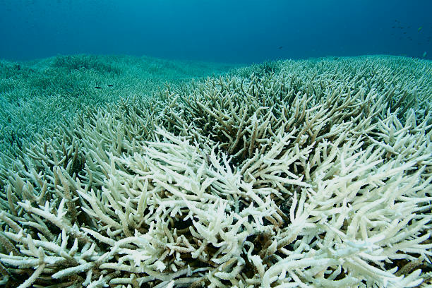


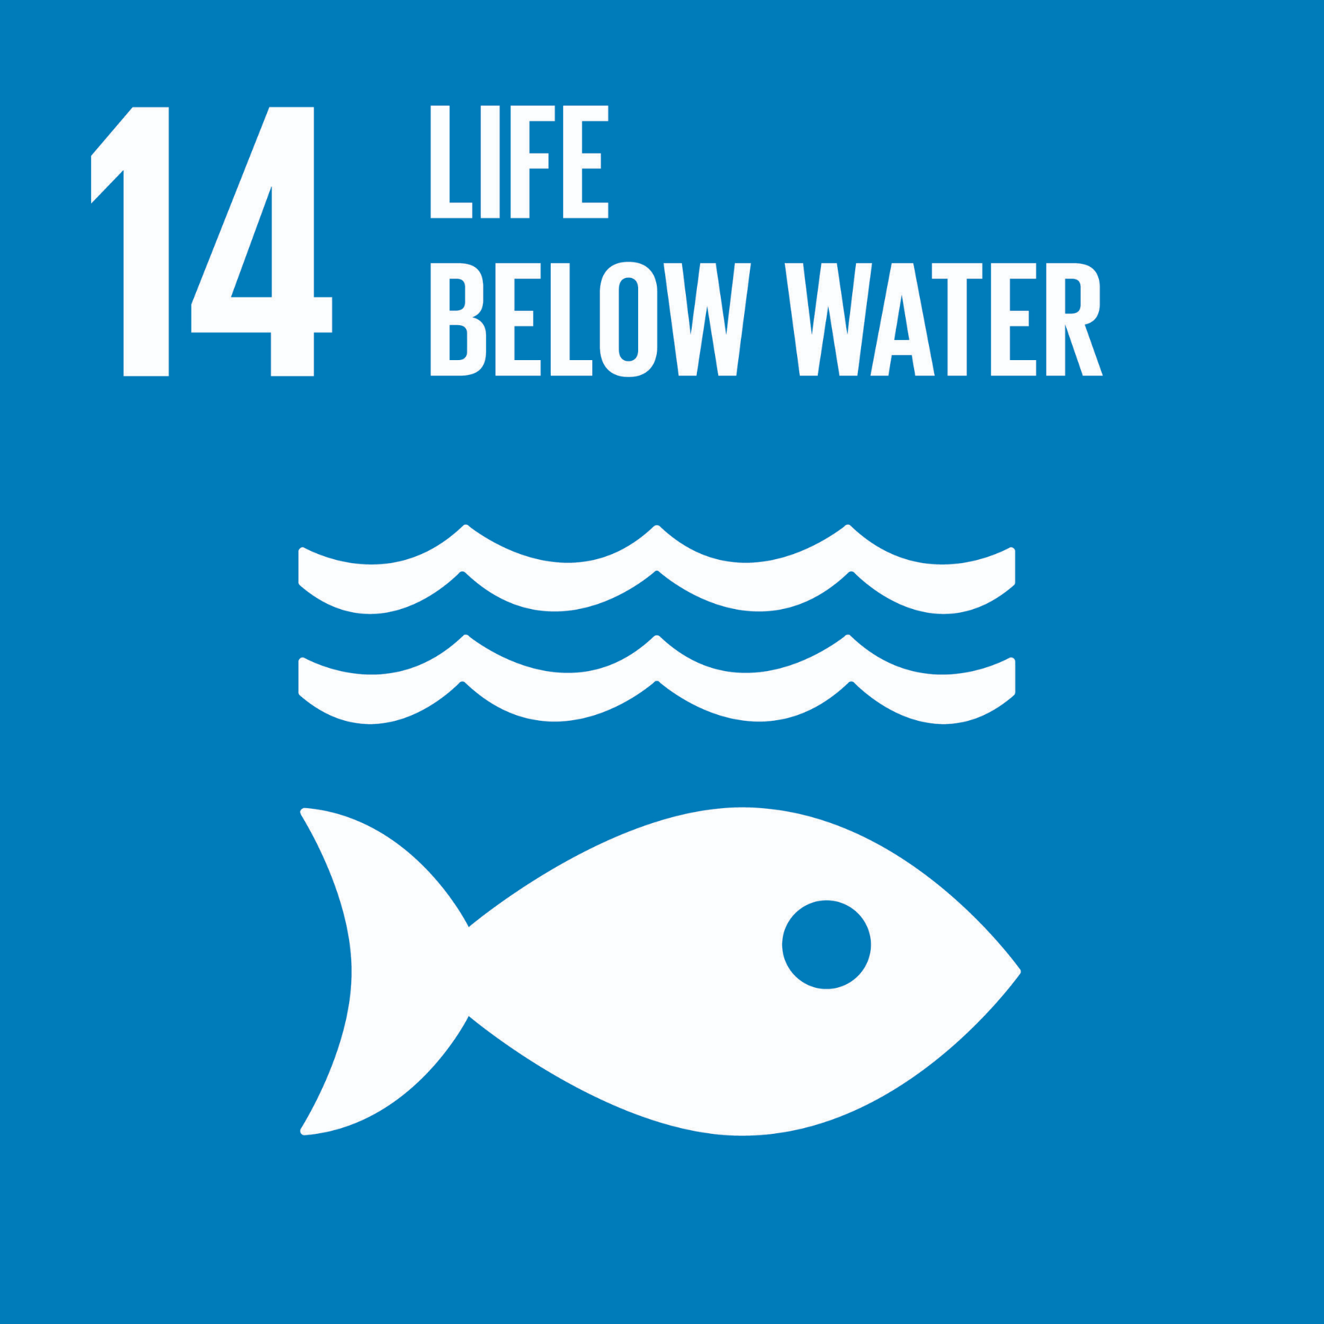
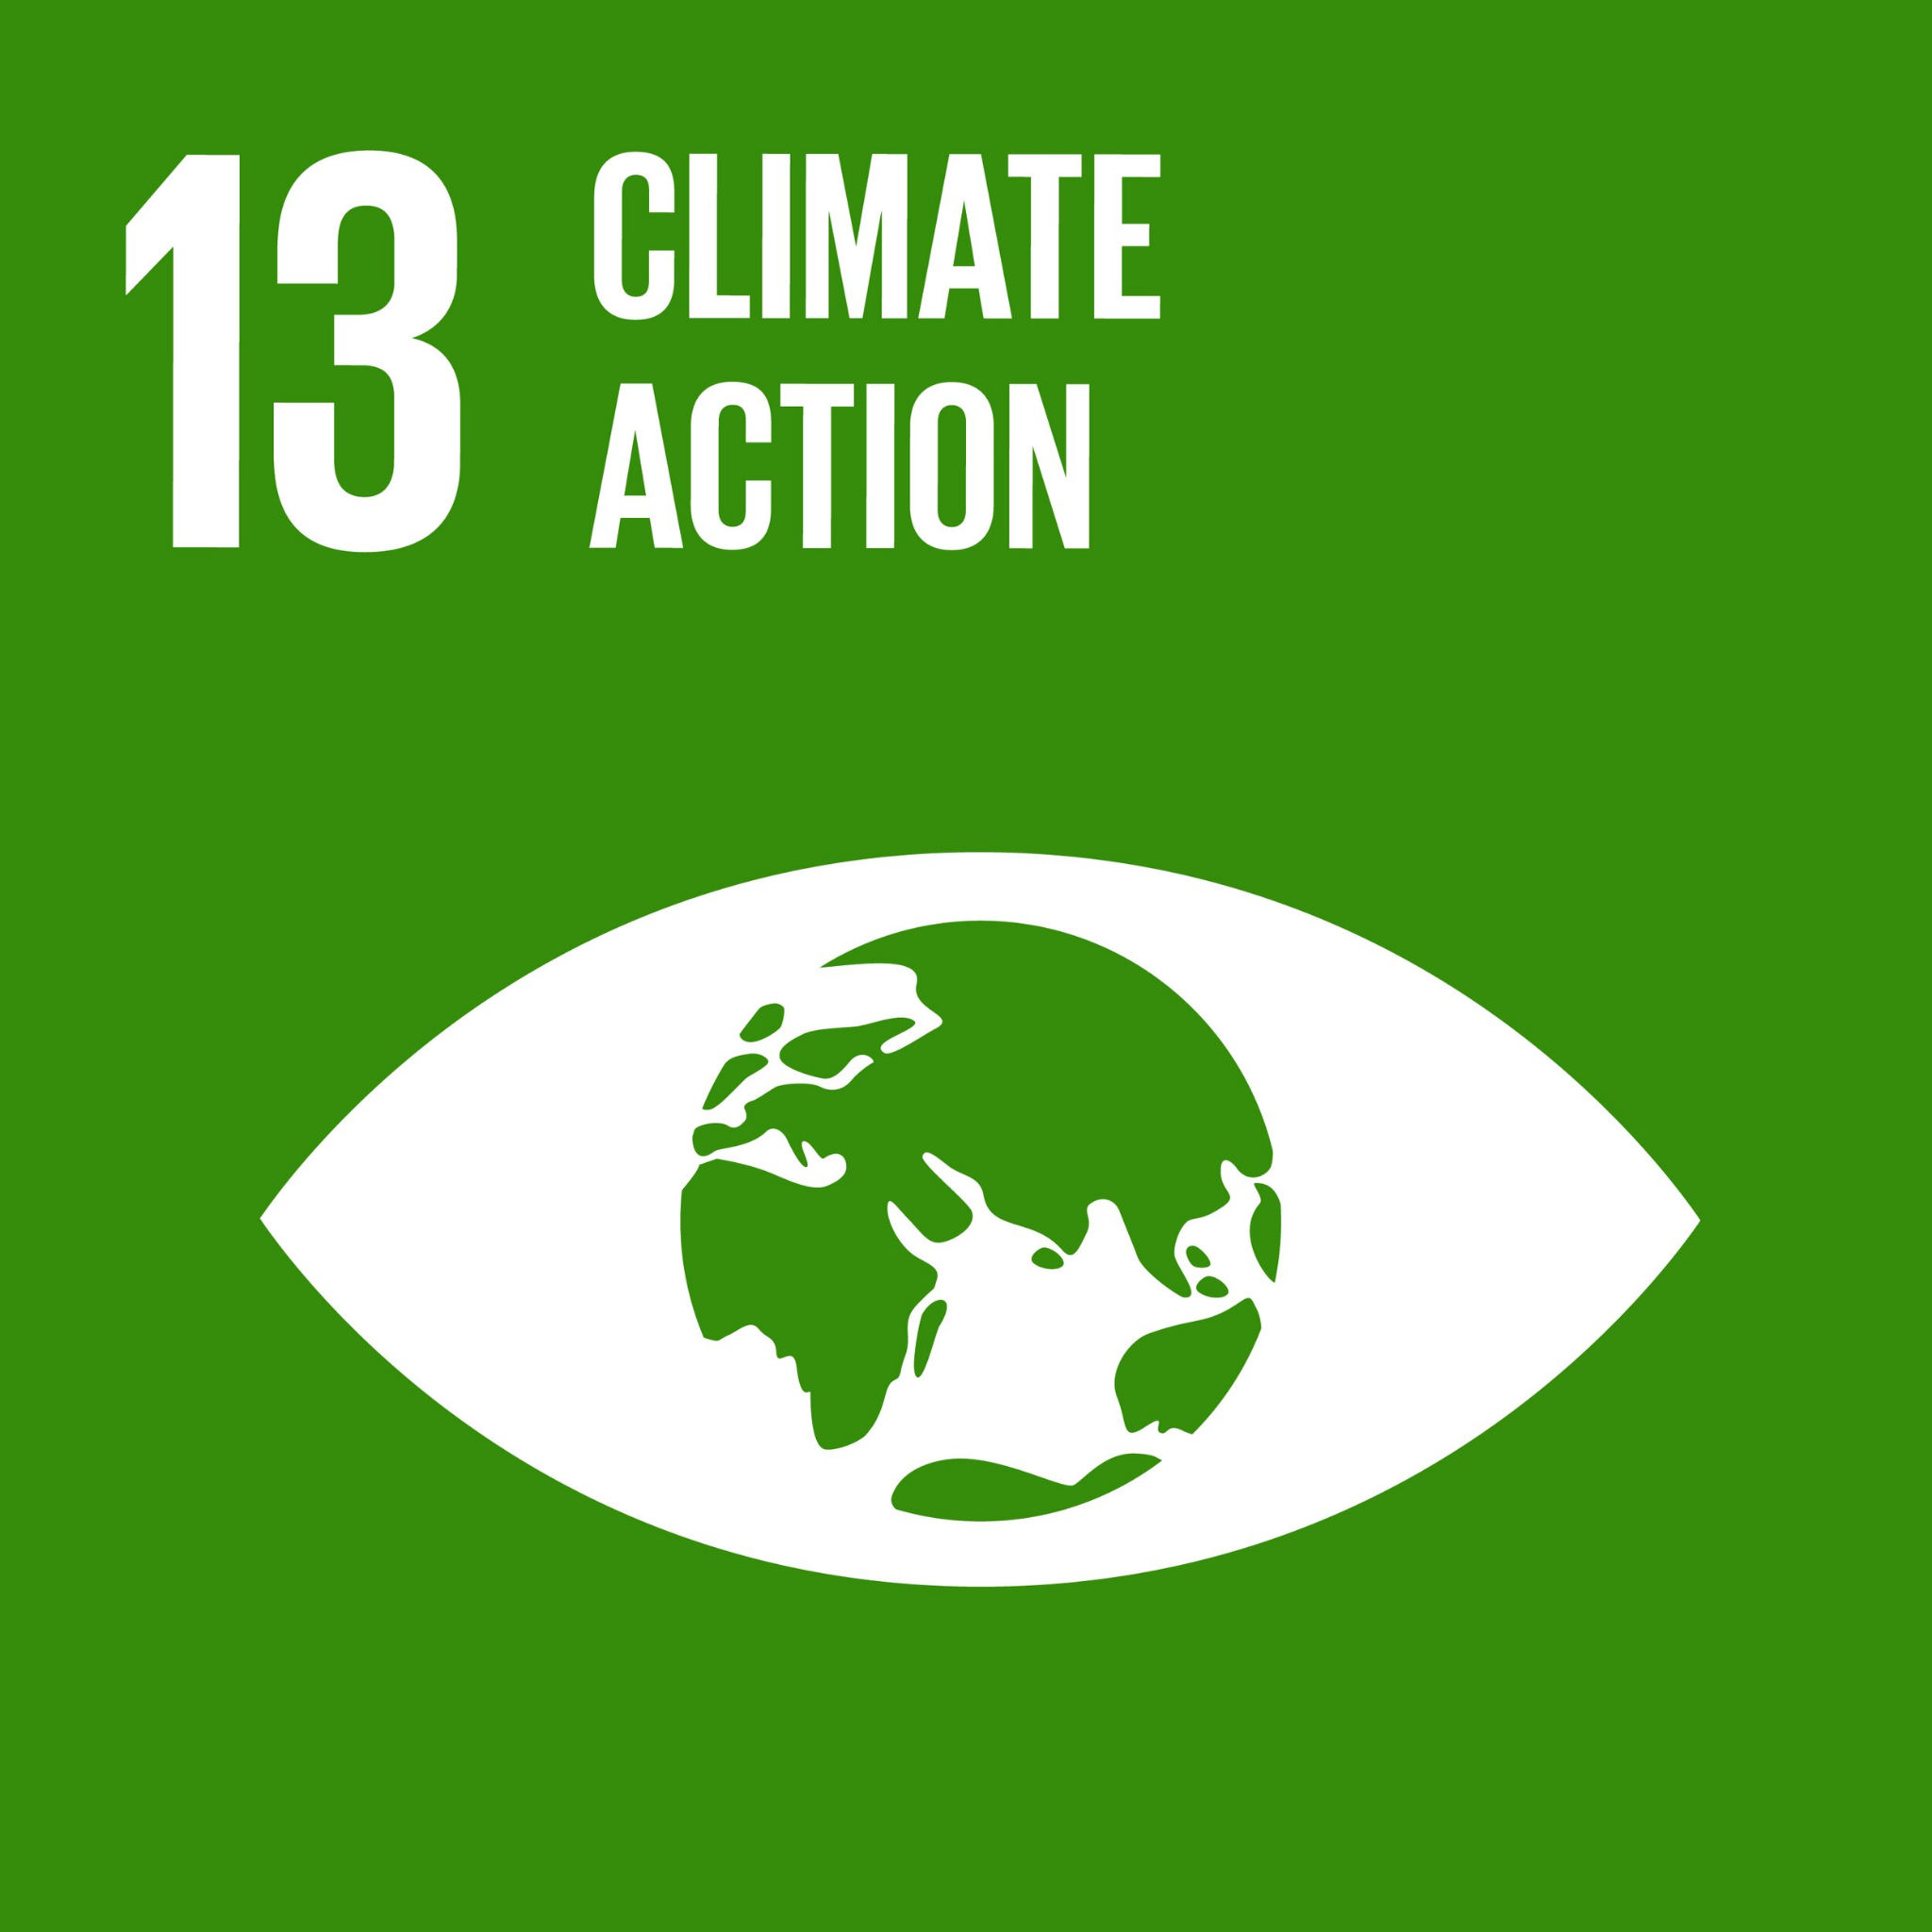
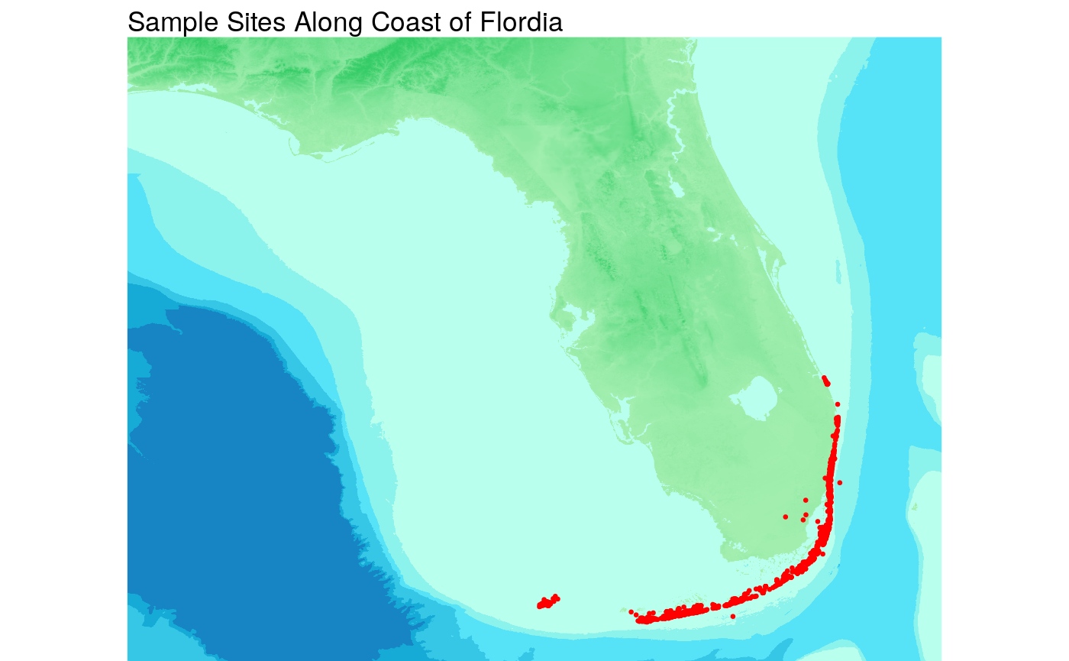
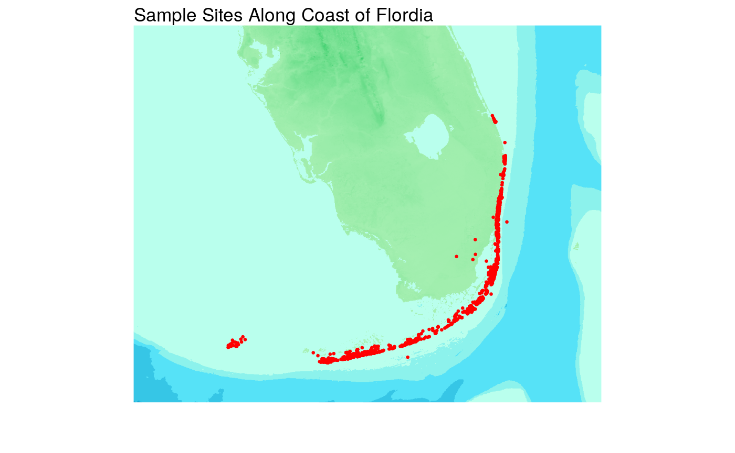
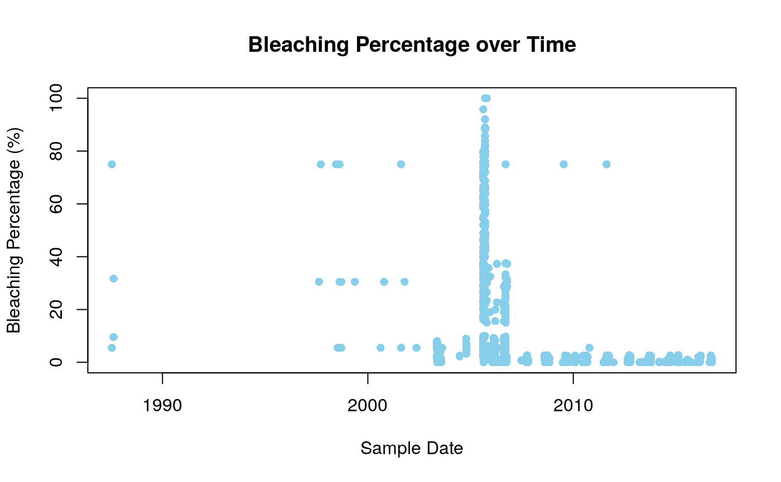
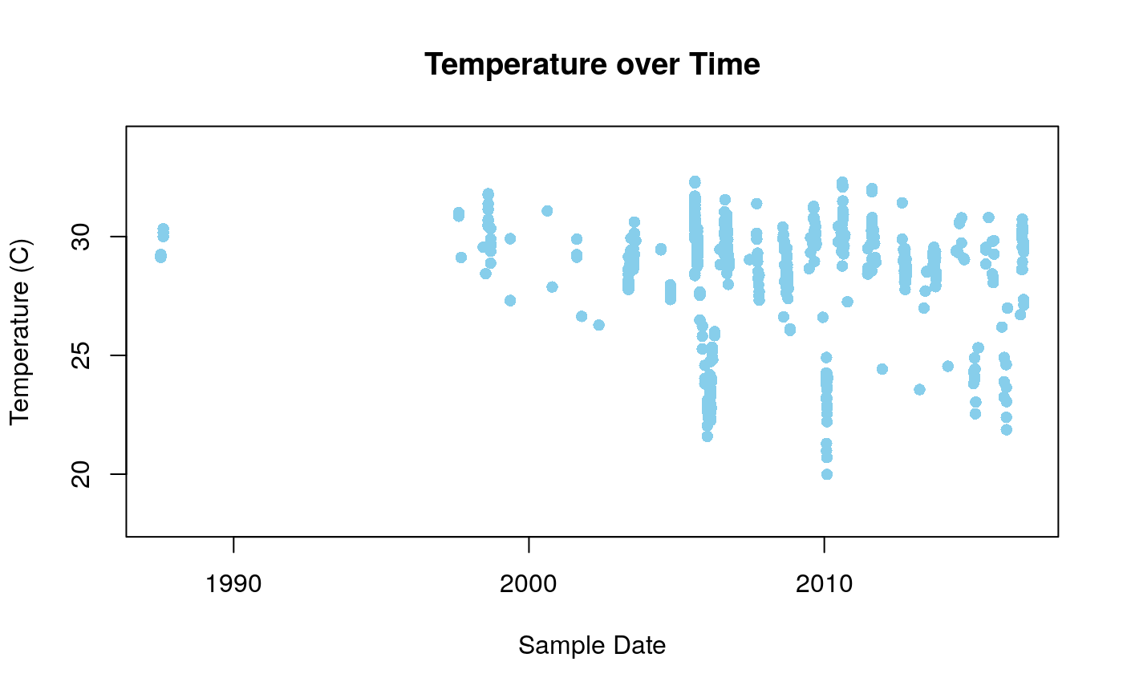
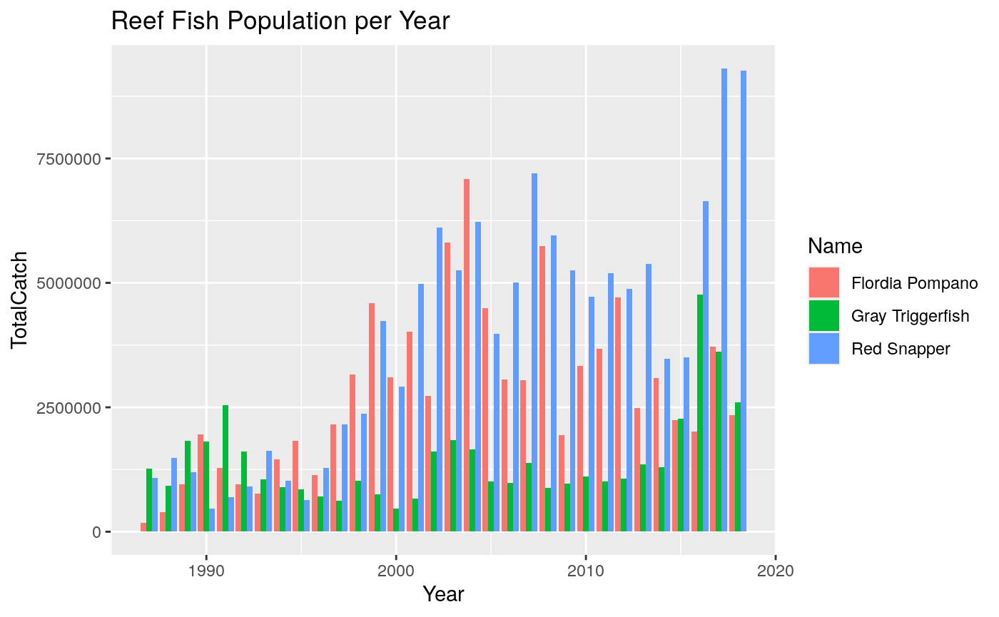
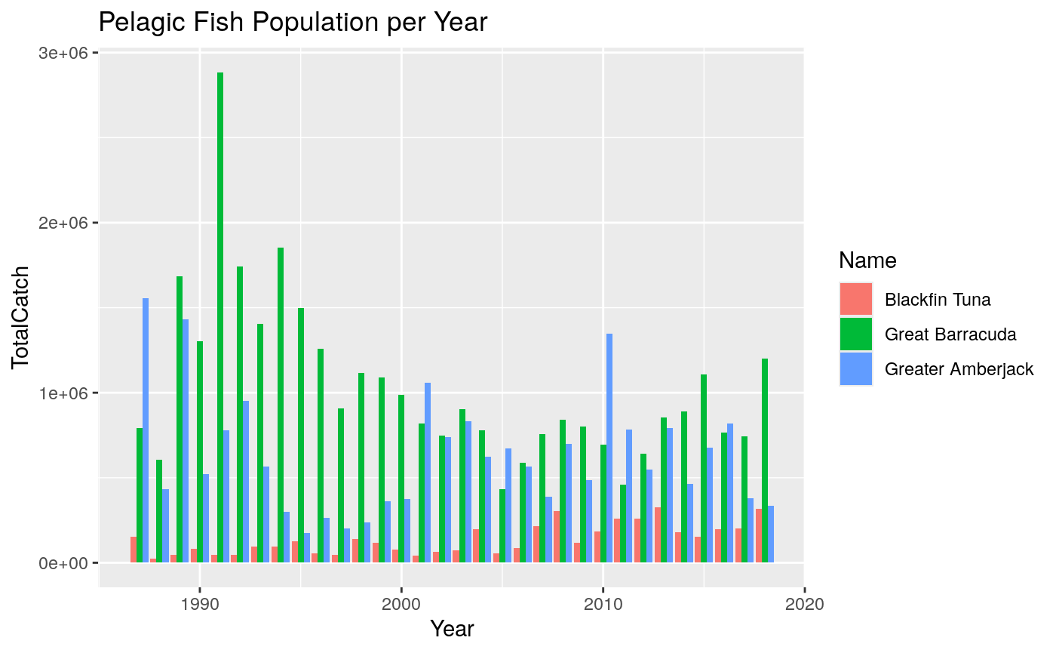









SOS: Combatting Coral Bleaching in Florida
Linking Coral Bleaching Severity with Reef and Pelagic Fish Population Declines in Florida (1987-2018)
Moanna Blaksteen, moanna.blaksteen@student.chaminade.edu, Chaminade University of Honolulu
Project Lead: Dr. Kelly Gaither, Texas Advanced Computing Center
Mentor(s): Kahoalii Keahi-Wood, Chaminade University of Honolulu & Alexis-Rachelle Ramelb, Chaminade University of Honolulu
Introduction
Tropical coral reefs, like those located along the coast of Florida, are among the richest and most diverse marine ecosystems on our planet. They are crucial in supporting the marine life which inhabits and surrounds the reef, and they have an interconnected relationship with many other facets of human existence, including food security, coastal protection, and economic development.
Unfortunately, the increased impacts of climate change are altering the state of our coral reefs, leading to coral bleaching events. These events occur when the symbiotic algae, or zooxanthellae, are expelled from the coral’s tissue as a result of changes to their marine environment¹. Changes such as the water temperature or pH levels can lead to the gradual loss of vibrant coral reefs, leaving behind graveyards of white, ‘bleached’ coral skeletons¹. The loss of these coral reefs leaves many reef fish without a habitat and food resources, which in turn serve as prey for pelagic fish, illustrating how one tier of the food chain relies on the other. This trend of increasing frequency and severity of bleaching events along the coast of Florida has been occurring regularly over the past few decades, causing much concern for the long-term survival of the reefs and the interdependent trophic hierarchy².
Data Visualizations
Results
Coral Bleaching Trends
Sample sites are distributed along the southern Florida coastline with various distances from the shoreline
Post-2005, there is an increase in bleaching frequency and severity, with bleaching percentages often exceeding 70%
The temperature values range between 19°C and 33°C, the lowest as 19.99°C in 2010 and highest as 32.33°C in 2005
The highest temperatures were experienced in 2005, 2010, and 2011 during the month of August
Reef Fish Population
Fish populations remain in an upward, albeit fluctuating, trend with noticeable declines in the years 2005-2006 and 2014-2015
The Red Snapper experienced a rapid increase in population from 2016-2018
Pelagic Fish Population
Great Barracuda and Great Amberjack undergo a declining trend of catches in the early 1990s
The Blackfin Tuna remains consistent throughout 1987-2018
Human Implications
Reef degradation can impact local fisheries, cause economic hardship for coastal communities, and inhibit climate regulatory abilities
Figure 1:
Figure 2:
x
Figure 1: A bathymetric map showing the entire state of Florida. The area of study for Florida’s coral reefs are displayed in red. [5]
Note: For the purpose of this research investigation, the outlier plot points (red points that are located on land areas) are omitted.
Figure 2: A bathymetric map showing a zoomed in image of the study area of southern Florida. The red plot points represent the individual sample sites, collected from the ‘Global Bleaching and Environmental Data.’ [5]
Note: For the purpose of this research investigation, the outlier plot points (red points that are located on land areas) are omitted.
Graph 1:
Graph 2:
Limitations
Data Availability and Quality: Reliance on previously conducted data may introduce limitations in accuracy, completeness, and the choice to omit certain measurements
Temporal and Spatial Constraints: The focus on specific time periods and locations may not capture all variations and trends in coral bleaching and its impacts on trophic hierarchy
Research Question
How have coral bleaching events along the southern coast of Florida from 1987 to 2018 impacted the trophic hierarchy within affected marine ecosystems, and what are the implications on human health?
Graph 1: Coral bleaching percentage for the sample sites in Florida from 1987 to 2018. The graph illustrates the changes in the extent of coral bleaching over the 31-year period, highlighting significant trends or events.
Graph 2: Temperature trends in Florida from 1987 to 2018. This graph shows the annual average temperatures over the 31-year period, indicating any long-term patterns or anomalies that may correlate with coral bleaching events.
Methods
Florida coral bleaching data was taken from the ‘Global Bleaching and Environmental Data’ public dataset from the Biological and Chemical Oceanography Data Management Office³
Reef and Pelagic fish population data was measured based on total catch, public datasets collected from the NOAA Fisheries Service⁴
Data was curated using R Studio, TACC Analysis Portal, Lonestar6 and Frontera Supercomputers, and Microsoft Excel
Statistical analysis was used to determine correlations or lack thereof between rates of coral bleaching in reefs along the coast of Florida between the years of 1987-2018 and the total catch populations of Florida-local marine fish
Graph 3:
Graph 4:
Future Works
Expanding the sample size to collect data for more locations along the entire coast of Florida
Conducting research to consider additional scientific measurements to expand the study and potential relationships between variables
References
[1] “What is coral bleaching?” 2024. NOAA's National Ocean Service. https://oceanservice.noaa.gov/facts/coral_bleach.html.
[2] “Coral Bleaching | FWC.” n.d. Florida Fish And Wildlife Conservation Commission. Accessed June 23, 2024. https://myfwc.com/research/habitat/coral/news-information/bleaching/.
[3] “Dataset: Bleaching and environmental data for global coral reef sites from 1980-2020.” n.d. Biological and Chemical Oceanography Data Management Office. Accessed June 24, 2024. https://www.bco-dmo.org/dataset/773466.
[4] “MRIP Catch Time Series Query.” n.d. NOAA Fisheries Service. Accessed June 24, 2024. https://www.st.nmfs.noaa.gov/SASStoredProcess/guest?_program=%2F%2FFoundation%2FSTP%2Fm[…]Effort+Query&qryparticipation=Select+a+Participation+Query.
[5] “GEBCO Gridded Bathymetry Data.” n.d. General Bathymetric Chart of the Oceans. Accessed June 24, 2024. https://gebco.net/data_and_products/gridded_bathymetry_data/.
Graph 3: The graph shows trends in total catch volume (sum of observed harvest, reported harvest, and released alive to represent abundance of each species) over time for three reef species: Florida Pompano, Gray Triggerfish, and the Red Snapper. This data represents the total catch in Florida for the years 1987 to 2018.
Graph 4: The graph shows trends in total catch volume (sum of observed harvest, reported harvest, and released alive to represent abundance of each species) over time for three pelagic species: Blackfin Tuna, Great Barracuda, and Greater Amberjack. This data represents the total catch in Florida for the years 1987 to 2018.

Slide 2
SOS: Combatting Coral Bleaching in Florida
Linking Coral Bleaching Severity with Reef and Pelagic Fish Population Declines in Florida (1987-2018)
Moanna Blaksteen, moanna.blaksteen@student.chaminade.edu, Chaminade University of Honolulu
Project Lead: Dr. Kelly Gaither, Texas Advanced Computing Center
Mentor(s): Kahoalii Keahi-Wood, Chaminade University of Honolulu & Alexis-Rachelle Ramelb, Chaminade University of Honolulu
Introduction
Tropical coral reefs, like those located along the coast of Florida, are among the richest and most diverse marine ecosystems on our planet. They are crucial in supporting the marine life which inhabits and surrounds the reef, and they have an interconnected relationship with many other facets of human existence, including food security, coastal protection, and economic development.
Unfortunately, the increased impacts of climate change are altering the state of our coral reefs, leading to coral bleaching events. These events occur when the symbiotic algae, or zooxanthellae, are expelled from the coral’s tissue as a result of changes to their marine environment¹. Changes such as the water temperature or pH levels can lead to the gradual loss of vibrant coral reefs, leaving behind graveyards of white, ‘bleached’ coral skeletons¹. The loss of these coral reefs leaves many reef fish without a habitat and food resources, which in turn serve as prey for pelagic fish, illustrating how one tier of the food chain relies on the other. This trend of increasing frequency and severity of bleaching events along the coast of Florida has been occurring regularly over the past few decades, causing much concern for the long-term survival of the reefs and the interdependent trophic hierarchy².

Slide 3
SOS: Combatting Coral Bleaching in Florida
Linking Coral Bleaching Severity with Reef and Pelagic Fish Population Declines in Florida (1987-2018)
Moanna Blaksteen, moanna.blaksteen@student.chaminade.edu, Chaminade University of Honolulu
Project Lead: Dr. Kelly Gaither, Texas Advanced Computing Center
Mentor(s): Kahoalii Keahi-Wood, Chaminade University of Honolulu & Alexis-Rachelle Ramelb, Chaminade University of Honolulu
Research Question
How have coral bleaching events along the southern coast of Florida from 1987 to 2018 impacted the trophic hierarchy within affected marine ecosystems, and what are the implications on human health?
Methods
Florida coral bleaching data was taken from the ‘Global Bleaching and Environmental Data’ public dataset from the Biological and Chemical Oceanography Data Management Office³
Reef and Pelagic fish population data was measured based on total catch, public datasets collected from the NOAA Fisheries Service⁴
Data was curated using R Studio, TACC Analysis Portal, Lonestar6 and Frontera Supercomputers, and Microsoft Excel
Statistical analysis was used to determine correlations or lack thereof between rates of coral bleaching in reefs along the coast of Florida between the years of 1987-2018 and the total catch populations of Florida-local marine fish

Slide 4
SOS: Combatting Coral Bleaching in Florida
Linking Coral Bleaching Severity with Reef and Pelagic Fish Population Declines in Florida (1987-2018)
Moanna Blaksteen, moanna.blaksteen@student.chaminade.edu, Chaminade University of Honolulu
Project Lead: Dr. Kelly Gaither, Texas Advanced Computing Center
Mentor(s): Kahoalii Keahi-Wood, Chaminade University of Honolulu & Alexis-Rachelle Ramelb, Chaminade University of Honolulu
Florida Sample Sites
Figure 1: A bathymetric map showing the entire state of Florida. The area of study for Florida’s coral reefs are displayed in red. [5]
* Note: For the purpose of this research investigation, the outlier plot points (red points that are located on land areas) are omitted.
Figure 2: A bathymetric map showing a zoomed in image of the study area of southern Florida. The red plot points represent the individual sample sites, collected from the ‘Global Bleaching and Environmental Data.’ [5]
* Note: For the purpose of this research investigation, the outlier plot points (red points that are located on land areas) are omitted.
Figure 1:
Figure 2:

Slide 5
SOS: Combatting Coral Bleaching in Florida
Linking Coral Bleaching Severity with Reef and Pelagic Fish Population Declines in Florida (1987-2018)
Moanna Blaksteen, moanna.blaksteen@student.chaminade.edu, Chaminade University of Honolulu
Project Lead: Dr. Kelly Gaither, Texas Advanced Computing Center
Mentor(s): Kahoalii Keahi-Wood, Chaminade University of Honolulu & Alexis-Rachelle Ramelb, Chaminade University of Honolulu
Bleaching and Temperature
Graph 1: Coral bleaching percentage for the sample sites in Florida from 1987 to 2018. The graph illustrates the changes in the extent of coral bleaching over the 31-year period, highlighting significant trends or events.
Graph 2: Temperature trends in Florida from 1987 to 2018. This graph shows the annual average temperatures over the 31-year period, indicating any long-term patterns or anomalies that may correlate with coral bleaching events.
Graph 1:
Graph 2:

Slide 6
SOS: Combatting Coral Bleaching in Florida
Linking Coral Bleaching Severity with Reef and Pelagic Fish Population Declines in Florida (1987-2018)
Moanna Blaksteen, moanna.blaksteen@student.chaminade.edu, Chaminade University of Honolulu
Project Lead: Dr. Kelly Gaither, Texas Advanced Computing Center
Mentor(s): Kahoalii Keahi-Wood, Chaminade University of Honolulu & Alexis-Rachelle Ramelb, Chaminade University of Honolulu
Reef and Pelagic Fish Populations
Graph 3: The graph shows trends in total catch volume (sum of observed harvest, reported harvest, and released alive to represent abundance of each species) over time for three reef species: Florida Pompano, Gray Triggerfish, and the Red Snapper. This data represents the total catch in Florida for the years 1987 to 2018.
Graph 4: The graph shows trends in total catch volume (sum of observed harvest, reported harvest, and released alive to represent abundance of each species) over time for three pelagic species: Blackfin Tuna, Great Barracuda, and Greater Amberjack. This data represents the total catch in Florida for the years 1987 to 2018.
Graph 3:
Graph 4:

Slide 7
SOS: Combatting Coral Bleaching in Florida
Linking Coral Bleaching Severity with Reef and Pelagic Fish Population Declines in Florida (1987-2018)
Moanna Blaksteen, moanna.blaksteen@student.chaminade.edu, Chaminade University of Honolulu
Project Lead: Dr. Kelly Gaither, Texas Advanced Computing Center
Mentor(s): Kahoalii Keahi-Wood, Chaminade University of Honolulu & Alexis-Rachelle Ramelb, Chaminade University of Honolulu
Introduction
Tropical coral reefs, like those located along the coast of Florida, are among the richest and most diverse marine ecosystems on our planet. They are crucial in supporting the marine life which inhabits and surrounds the reef, and they have an interconnected relationship with many other facets of human existence, including food security, coastal protection, and economic development.
Unfortunately, the increased impacts of climate change are altering the state of our coral reefs, leading to coral bleaching events. These events occur when the symbiotic algae, or zooxanthellae, are expelled from the coral’s tissue as a result of changes to their marine environment¹. Changes such as the water temperature or pH levels can lead to the gradual loss of vibrant coral reefs, leaving behind graveyards of white, ‘bleached’ coral skeletons¹. The loss of these coral reefs leaves many reef fish without a habitat and food resources, which in turn serve as prey for pelagic fish, illustrating how one tier of the food chain relies on the other. This trend of increasing frequency and severity of bleaching events along the coast of Florida has been occurring regularly over the past few decades, causing much concern for the long-term survival of the reefs and the interdependent trophic hierarchy².
Data Visualizations
Results
Coral Bleaching Trends
Sample sites are distributed along the southern Florida coastline with various distances from the shoreline
Post-2005, there is an increase in bleaching frequency and severity, with bleaching percentages often exceeding 70%
The temperature values range between 19°C and 33°C, the lowest as 19.99°C in 2010 and highest as 32.33°C in 2005
The highest temperatures were experienced in 2005, 2010, and 2011 during the month of August
Reef Fish Population
Fish populations remain in an upward, albeit fluctuating, trend with noticeable declines in the years 2005-2006 and 2014-2015
The Red Snapper experienced a rapid increase in population from 2016-2018
Pelagic Fish Population
Great Barracuda and Great Amberjack undergo a declining trend of catches in the early 1990s
The Blackfin Tuna remains consistent throughout 1987-2018
Human Implications
Reef degradation can impact local fisheries, cause economic hardship for coastal communities, and inhibit climate regulatory abilities
Figure 1:
Figure 2:
x
Figure 1: A bathymetric map showing the entire state of Florida. The area of study for Florida’s coral reefs are displayed in red. [5]
Note: For the purpose of this research investigation, the outlier plot points (red points that are located on land areas) are omitted.
Figure 2: A bathymetric map showing a zoomed in image of the study area of southern Florida. The red plot points represent the individual sample sites, collected from the ‘Global Bleaching and Environmental Data.’ [5]
Note: For the purpose of this research investigation, the outlier plot points (red points that are located on land areas) are omitted.
Graph 1:
Graph 2:
Limitations
Data Availability and Quality: Reliance on previously conducted data may introduce limitations in accuracy, completeness, and the choice to omit certain measurements
Temporal and Spatial Constraints: The focus on specific time periods and locations may not capture all variations and trends in coral bleaching and its impacts on trophic hierarchy
Research Question
How have coral bleaching events along the southern coast of Florida from 1987 to 2018 impacted the trophic hierarchy within affected marine ecosystems, and what are the implications on human health?
Graph 1: Coral bleaching percentage for the sample sites in Florida from 1987 to 2018. The graph illustrates the changes in the extent of coral bleaching over the 31-year period, highlighting significant trends or events.
Graph 2: Temperature trends in Florida from 1987 to 2018. This graph shows the annual average temperatures over the 31-year period, indicating any long-term patterns or anomalies that may correlate with coral bleaching events.
Methods
Florida coral bleaching data was taken from the ‘Global Bleaching and Environmental Data’ public dataset from the Biological and Chemical Oceanography Data Management Office³
Reef and Pelagic fish population data was measured based on total catch, public datasets collected from the NOAA Fisheries Service⁴
Data was curated using R Studio, TACC Analysis Portal, Lonestar6 and Frontera Supercomputers, and Microsoft Excel
Statistical analysis was used to determine correlations or lack thereof between rates of coral bleaching in reefs along the coast of Florida between the years of 1987-2018 and the total catch populations of Florida-local marine fish
Graph 3:
Graph 4:
Future Works
Expanding the sample size to collect data for more locations along the entire coast of Florida
Conducting research to consider additional scientific measurements to expand the study and potential relationships between variables
References
[1] “What is coral bleaching?” 2024. NOAA's National Ocean Service. https://oceanservice.noaa.gov/facts/coral_bleach.html.
[2] “Coral Bleaching | FWC.” n.d. Florida Fish And Wildlife Conservation Commission. Accessed June 23, 2024. https://myfwc.com/research/habitat/coral/news-information/bleaching/.
[3] “Dataset: Bleaching and environmental data for global coral reef sites from 1980-2020.” n.d. Biological and Chemical Oceanography Data Management Office. Accessed June 24, 2024. https://www.bco-dmo.org/dataset/773466.
[4] “MRIP Catch Time Series Query.” n.d. NOAA Fisheries Service. Accessed June 24, 2024. https://www.st.nmfs.noaa.gov/SASStoredProcess/guest?_program=%2F%2FFoundation%2FSTP%2Fm[…]Effort+Query&qryparticipation=Select+a+Participation+Query.
[5] “GEBCO Gridded Bathymetry Data.” n.d. General Bathymetric Chart of the Oceans. Accessed June 24, 2024. https://gebco.net/data_and_products/gridded_bathymetry_data/.
Graph 3: The graph shows trends in total catch volume (sum of observed harvest, reported harvest, and released alive to represent abundance of each species) over time for three reef species: Florida Pompano, Gray Triggerfish, and the Red Snapper. This data represents the total catch in Florida for the years 1987 to 2018.
Graph 4: The graph shows trends in total catch volume (sum of observed harvest, reported harvest, and released alive to represent abundance of each species) over time for three pelagic species: Blackfin Tuna, Great Barracuda, and Greater Amberjack. This data represents the total catch in Florida for the years 1987 to 2018.

Slide 8
SOS: Combatting Coral Bleaching in Florida
Linking Coral Bleaching Severity with Reef and Pelagic Fish Population Declines in Florida (1987-2018)
Moanna Blaksteen, moanna.blaksteen@student.chaminade.edu, Chaminade University of Honolulu
Project Lead: Dr. Kelly Gaither, Texas Advanced Computing Center
Mentor(s): Kahoalii Keahi-Wood, Chaminade University of Honolulu & Alexis-Rachelle Ramelb, Chaminade University of Honolulu
Limitations
Data Availability and Quality: Reliance on previously conducted data may introduce limitations in accuracy, completeness, and the choice to omit certain measurements
Temporal and Spatial Constraints: The focus on specific time periods and locations may not capture all variations and trends in coral bleaching and its impacts on trophic hierarchy
Future Works
Expanding the sample size to collect data for more locations along the entire coast of Florida
Conducting more research to investigate additional scientific measurements, such as salinity and dissolved oxygen, to expand the study and find further relationships

Slide 9
SOS: Combatting Coral Bleaching in Florida
Linking Coral Bleaching Severity with Reef and Pelagic Fish Population Declines in Florida (1987-2018)
Moanna Blaksteen, moanna.blaksteen@student.chaminade.edu, Chaminade University of Honolulu
Project Lead: Dr. Kelly Gaither, Texas Advanced Computing Center
Mentor(s): Kahoalii Keahi-Wood, Chaminade University of Honolulu & Alexis-Rachelle Ramelb, Chaminade University of Honolulu
Introduction
Tropical coral reefs, like those located along the coast of Florida, are among the richest and most diverse marine ecosystems on our planet. They are crucial in supporting the marine life which inhabits and surrounds the reef, and they have an interconnected relationship with many other facets of human existence, including food security, coastal protection, and economic development.
Unfortunately, the increased impacts of climate change are altering the state of our coral reefs, leading to coral bleaching events. These events occur when the symbiotic algae, or zooxanthellae, are expelled from the coral’s tissue as a result of changes to their marine environment¹. Changes such as the water temperature or pH levels can lead to the gradual loss of vibrant coral reefs, leaving behind graveyards of white, ‘bleached’ coral skeletons¹. The loss of these coral reefs leaves many reef fish without a habitat and food resources, which in turn serve as prey for pelagic fish, illustrating how one tier of the food chain relies on the other. This trend of increasing frequency and severity of bleaching events along the coast of Florida has been occurring regularly over the past few decades, causing much concern for the long-term survival of the reefs and the interdependent trophic hierarchy².
Data Visualizations
Results
Coral Bleaching Trends
Sample sites are distributed along the southern Florida coastline with various distances from the shoreline
Post-2005, there is an increase in bleaching frequency and severity, with bleaching percentages often exceeding 70%
The temperature values range between 19°C and 33°C, the lowest as 19.99°C in 2010 and highest as 32.33°C in 2005
The highest temperatures were experienced in 2005, 2010, and 2011 during the month of August
Reef Fish Population
Fish populations remain in an upward, albeit fluctuating, trend with noticeable declines in the years 2005-2006 and 2014-2015
The Red Snapper experienced a rapid increase in population from 2016-2018
Pelagic Fish Population
Great Barracuda and Great Amberjack undergo a declining trend of catches in the early 1990s
The Blackfin Tuna remains consistent throughout 1987-2018
Human Implications
Reef degradation can impact local fisheries, cause economic hardship for coastal communities, and inhibit climate regulatory abilities
Figure 1:
Figure 2:
x
Figure 1: A bathymetric map showing the entire state of Florida. The area of study for Florida’s coral reefs are displayed in red. [5]
Note: For the purpose of this research investigation, the outlier plot points (red points that are located on land areas) are omitted.
Figure 2: A bathymetric map showing a zoomed in image of the study area of southern Florida. The red plot points represent the individual sample sites, collected from the ‘Global Bleaching and Environmental Data.’ [5]
Note: For the purpose of this research investigation, the outlier plot points (red points that are located on land areas) are omitted.
Graph 1:
Graph 2:
Limitations
Data Availability and Quality: Reliance on previously conducted data may introduce limitations in accuracy, completeness, and the choice to omit certain measurements
Temporal and Spatial Constraints: The focus on specific time periods and locations may not capture all variations and trends in coral bleaching and its impacts on trophic hierarchy
Research Question
How have coral bleaching events along the southern coast of Florida from 1987 to 2018 impacted the trophic hierarchy within affected marine ecosystems, and what are the implications on human health?
Graph 1: Coral bleaching percentage for the sample sites in Florida from 1987 to 2018. The graph illustrates the changes in the extent of coral bleaching over the 31-year period, highlighting significant trends or events.
Graph 2: Temperature trends in Florida from 1987 to 2018. This graph shows the annual average temperatures over the 31-year period, indicating any long-term patterns or anomalies that may correlate with coral bleaching events.
Methods
Florida coral bleaching data was taken from the ‘Global Bleaching and Environmental Data’ public dataset from the Biological and Chemical Oceanography Data Management Office³
Reef and Pelagic fish population data was measured based on total catch, public datasets collected from the NOAA Fisheries Service⁴
Data was curated using R Studio, TACC Analysis Portal, Lonestar6 and Frontera Supercomputers, and Microsoft Excel
Statistical analysis was used to determine correlations or lack thereof between rates of coral bleaching in reefs along the coast of Florida between the years of 1987-2018 and the total catch populations of Florida-local marine fish
Graph 3:
Graph 4:
Future Works
Expanding the sample size to collect data for more locations along the entire coast of Florida
Conducting research to consider additional scientific measurements to expand the study and potential relationships between variables
References
[1] “What is coral bleaching?” 2024. NOAA's National Ocean Service. https://oceanservice.noaa.gov/facts/coral_bleach.html.
[2] “Coral Bleaching | FWC.” n.d. Florida Fish And Wildlife Conservation Commission. Accessed June 23, 2024. https://myfwc.com/research/habitat/coral/news-information/bleaching/.
[3] “Dataset: Bleaching and environmental data for global coral reef sites from 1980-2020.” n.d. Biological and Chemical Oceanography Data Management Office. Accessed June 24, 2024. https://www.bco-dmo.org/dataset/773466.
[4] “MRIP Catch Time Series Query.” n.d. NOAA Fisheries Service. Accessed June 24, 2024. https://www.st.nmfs.noaa.gov/SASStoredProcess/guest?_program=%2F%2FFoundation%2FSTP%2Fm[…]Effort+Query&qryparticipation=Select+a+Participation+Query.
[5] “GEBCO Gridded Bathymetry Data.” n.d. General Bathymetric Chart of the Oceans. Accessed June 24, 2024. https://gebco.net/data_and_products/gridded_bathymetry_data/.
Graph 3: The graph shows trends in total catch volume (sum of observed harvest, reported harvest, and released alive to represent abundance of each species) over time for three reef species: Florida Pompano, Gray Triggerfish, and the Red Snapper. This data represents the total catch in Florida for the years 1987 to 2018.
Graph 4: The graph shows trends in total catch volume (sum of observed harvest, reported harvest, and released alive to represent abundance of each species) over time for three pelagic species: Blackfin Tuna, Great Barracuda, and Greater Amberjack. This data represents the total catch in Florida for the years 1987 to 2018.

Slide 10
Acknowledgements
Mahalo nui loa!
Kelly Gaither
Kahoalii Keahi-Wood
Alexis-Rachelle Ramelb
Questions?

